Slide 1
Module 6 Software Risk, Configuration management and Quality Assurance
6.1 Risk identification, Risk Assessment, Risk projection (estimation)
RMMM (Risk mitigation, monitoring, and management )
6.2 Software configuration management, SCM Repository, SCM Process
6.3 Software Quality Assurance Task and Plan, Metrics, Software Reliability, Formal Technical Review(FTR) and walkthrough

Slide 2
Quality Defined (continued)
Two kinds of quality are sought out
Quality of design
The characteristic that designers specify for an item
This encompasses requirements, specifications, and the design of the system
Quality of conformance (i.e., implementation)
The degree to which the design specifications are followed during manufacturing
This focuses on how well the implementation follows the design and how well the resulting system meets its requirements
Quality also can be looked at in terms of user satisfaction User satisfaction = compliant product + good quality + delivery within budget and schedule
2

Slide 3
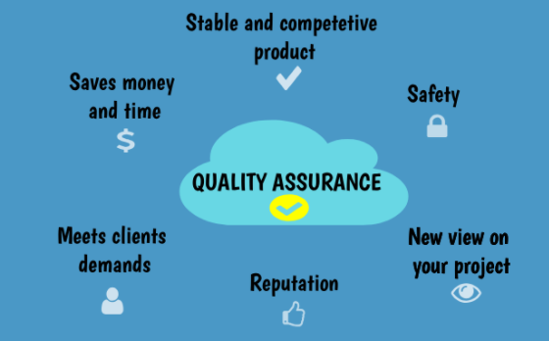
Quality Assurance(QA)

Slide 4
Quality Assurance Functions
Consists of a set of auditing and reporting functions that assess the effectiveness and completeness of quality control activities
Provides management personnel with data that provides insight into the quality of the products
Alerts management personnel to quality problems so that they can apply the necessary resources to resolve quality issues
4

Slide 5
The SQA Group
Serves as the customer's in-house representative
Assists the software team in achieving a high-quality product
Views the software from the customer's point of view
Does the software adequately meet quality factors?
Has software development been conducted according to pre-established standards?
Have technical disciplines properly performed their roles as part of the SQA activity?
Performs a set of activities that address quality assurance planning, oversight, record keeping, analysis, and reporting
5

Slide 6
SQA Activities
1. Prepares an SQA Plan for a project
2. Participates in the development of the project’s software process description
3. Reviews software engineering activities to verify compliance with the defined software process
4. Audits designated software work products to verify compliance with those defined as part of the software process
5. Ensures that deviations in the software work and work products are documented and handled accordingly to a documented procedure
6. Records any non compliance and reports to senior management

Slide 7
Contd..
7. Coordinates the control and management of change
8. Helps to collect and analyze software metrics
7

Slide 8
SQA Plan
It contains the following sections:-
Initial section
Management section
Documentation section
Standard, Practices and conventions section
Reviews and Audit section
Test section
Remainder section

Slide 9
Quality Control
Involves a series of inspections, reviews, and tests used throughout the software process
Ensures that each work product meets the requirements placed on it
Includes a feedback loop to the process that created the work product
This is essential in minimizing the errors produced
Combines measurement and feedback in order to adjust the process when product specifications are not met
Requires all work products to have defined, measurable specifications to which practitioners may compare to the output of each process
9

Slide 10
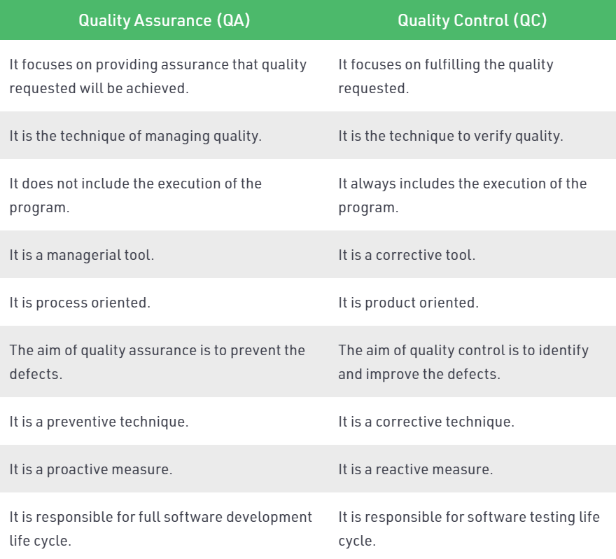
Comparison between QA and QC

Slide 11
Metrics
A metric is a verifiable measure stated in either quantitative or qualitative terms.
The Metrics captures performance in terms of how something is being done relative to a standard,
It allows and encourages comparison,
It supports business strategy.

Slide 12
Metrics for Software Quality
The goal of software engineering is to produce high quality system, application or product.
The quality of software depends upon:
Requirements that describe the problem
The design method used to produce the software
The code that leads to executable program
The tests that are carried out in order to uncover the errors from the software.

Slide 13
Metrics for Software Quality
The project manager evaluates the quality of the software project using following factors-
Errors and defects in the software
Quality metrics collected by each software engineer who is involved in the software development process.
The following metrics are used for software quality-
Work product errors per function
Errors found in the per review hour
Errors found in the testing

Slide 14
Measurement of Software Quality
Correctness
Maintainability
Integrity
Usability
Defect Removal Eficiency

Slide 15
Correctness
Correctness is a degree to which the software produces the desired functionality. The correctness can be measured as
Correctness = Defects per KLOC
where defects means lack of conformance to requirements.
Such defects are generally reported by the user of the program

Slide 16
Maintainability
Maintainability is the ability of the system to accommodate the corrections made after encountering errors, adapting to the environment and adapt to the changes made in the system in order to satisfy the user.
The metric used for maintainability is MTTC i.e. Mean Time to Change.
The MTTC can be defined as the time required to analyze the change request, design an appropriate modification and implementation of those desired changes.
Lower the value of MTTC means the software is more maintainable.

Slide 17
Integrity
Integrity is basically an ability of the system to withstand against the attacks. Typically attacks are on programs, data and documents.
There are two attributes that are associated with integrity: threat and security.
Threat is the probability that specific types of attacks may occur.
Security is the probability that the system will repel against the specific attacks.
Integrity can be measured as:
Integrity = ∑ ((1-threat) * (1-security))

Slide 18
Usability
Usability means user friendliness of the system or ability of the system that indicates the usefulness of the system.
Following are the characteristics that are useful for measuring the usability. The user friendliness is measured using following four characteristics –
The time required to become moderately efficient in the use of the system efficient
The physical or intellectual skill required to learn the system
The net increase in productivity after regular use of the system
A subjective assessment of users attitude towards the system.

Slide 19
Defect Removal efficiency
While developing the software project many work products such as SRS, design document, source code are being created.
Along with these work products many errors may get generated. Project manager has to identify all these errors to bring quality software.
Error tracking is a process of assessing the status of the software project.
The software team performs the formal technical reviews to test the software developed. In this review various errors are identified and corrected.
Any errors that remain uncovered and are found in later are called defects.

Slide 20
Defect Removal efficiency
DRE = E/(E+D)
where DRE is the defect removal efficiency, E is the error and D is defect.
The DRE represents the effectiveness of quality assurance activities.
The DRE also helps the project manager to assess the progress of software project as it gets developed through its scheduled work task.
Ideal value of DRE is 1

Slide 21
Software Reliability
It is defined as “the probability of failure-free operation of a computer program in a specified environment for a specified time”
Failure: It is the non conformance to software requirements

Slide 22
Measures of Reliability
Measure of Reliability
MTBF=MTTF+MTTR
MTBF- Mean time between failure
MTTF-Mean time to failure
MTTR-Mean time to repair

Slide 23
Software Availability
It is defined as “the probability that a program is operating according to requirements at a given point in time
Measure of Availability
Availability=[MTTF/(MTTF+MTTR)]*100%

Slide 24
